Slide 1
IRCC11-07A
HYDROGRAPHIC COMMISSION ON ANTARCTICA (HCA)
HCA report to IRCC11
Genoa, Italy 3-5 June 2019

Slide 2
Outline of HCA
Membership
Chair: Dr Mathias JONAS (IHO Secretariat) from September 2017
Vice-Chair: Mr Patrick DORR (United States) from June 2018
Secretary: Yves Guillam (IHO Secretariat)
Members: Argentina, Australia, Brazil, Chile, China, Colombia, Ecuador, France, Germany, Greece, India, Italy, Japan, Korea (Rep. of), New Zealand, Norway, Peru, Russian Federation, South Africa, Spain, Uruguay, United Kingdom, USA, Venezuela.
Observers: Antarctic Treaty Secretariat (ATS), Council of Managers of National Antarctic Programmes (COMNAP), International Association of Antarctic Tour Operators (IAATO), Scientific Committee on Antarctic Research (SCAR), International Maritime Organization (IMO), Intergovernmental Oceanographic Commission (IOC), General Bathymetric Chart of the Oceans (GEBCO), International Bathymetric Chart of the Southern Ocean (IBCSO).

Slide 3
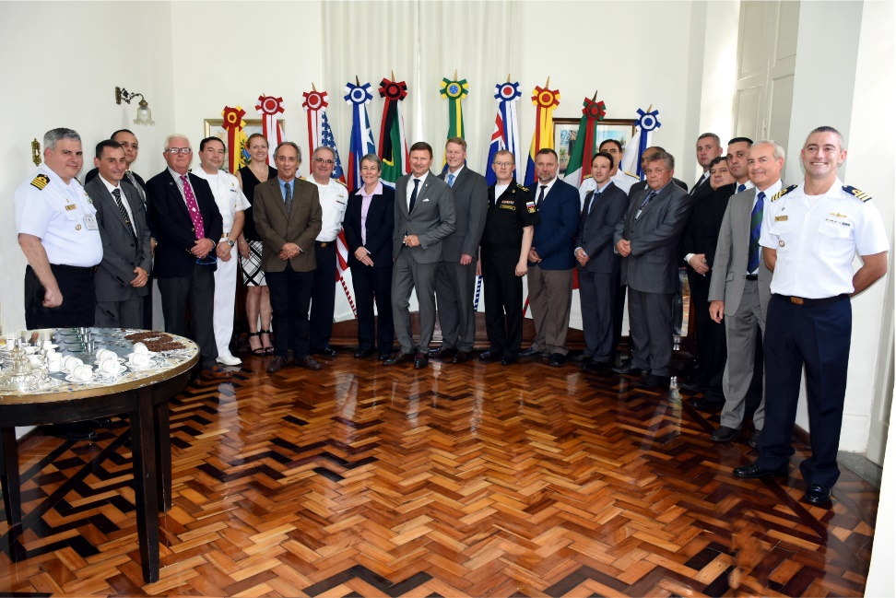
Meetings since IRCC10 (June 2018)
Meetings:
Following BSHC meetings have taken place:
15th HCA Conference 26 - 28 June 2018 (Niterói, Brazil)
Next meeting: 16th HCA Conference 3 – 5 July 2019 (Prague, CZ) in conjunction with ATCM XLII Conference
Current HCA Working Groups:
Hydrographic Priorities Working Group (HPWG)

Slide 4
Activities
Check and monitor ENC overlap
HCA agreed that the Region M Coordinator, in liaison with IHO Secretariat and the RENCs, has the responsibility to check and monitor ENC overlaps within the Antarctic region.
Extraction of bathymetric information for IHO DCDB
HCA agreed on the principles following up Action C1/34, that HCA Members should be encouraged to ensure that bathymetric information contained in their HCA ENCs should be extracted and transmitted to the IHO DCDB.
S-100 product based services for Antarctic waters
HCA agreed that, as a matter of principles, the current primary charting authorities in Antarctica should be encouraged to consider the future production and distribution of S-100 based products for Antarctica, in their areas of charting responsibilities.

Slide 5
Cooperation with stakeholders (1)
Strengthen GEBCO/Seabed 2030
Improve DCDB coverage in Antarctic waters through implementation of a crowd-sourced bathymetry practice and the acquisition of professional multibeam data contributions from research vessels operating in the area.
Apply B-12
IAATO agreed to check if the new guidance on crowd-sourced bathymetry (B-12) can be implemented technically – possibly by export from Voyage Data Recorder recordings.
IAATO - International Association of Antarctic Tour Operators
Approach the fleet of research vessels
COMNAP invited to bring the matter of collecting hydrographic data (single beam crowd-sourced bathymetry and professional multibeam) as a matter of routine to the attention of the COMNAP membership and for COMNAP to report progress to HCA Conferences.
COMNAP - Council of Managers of National Antarctic Programmes

Slide 6
Cooperation with stakeholders (2)
Contribute to the 42nd ATCM-Conference
HCA members will provide a half day Seminar about hydrography in Antarctic waters at the 42nd Conference in July 2019 in Prague, CZ. The Seminar will include specific contributions of the National Hydrographers of Chile and UK.
The back to back meeting of HCA with ATCM XLII and the contribution of HCA members at this important event offers an excellent opportunity to highlight the importance of hydrography and bathymetry for Antarctica as a whole.
Some ATCM (IHO) Member States will second through the proposal to update the Resolution on Hydrographic Mapping in Antarctic waters;

Slide 7
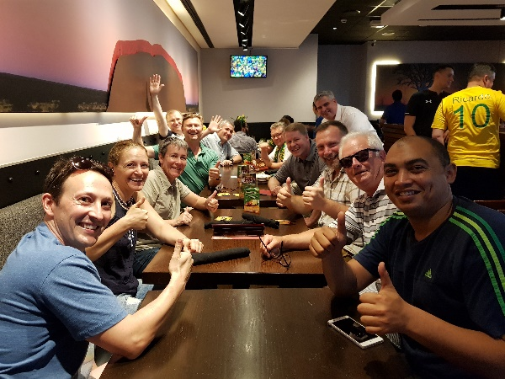
Achievements
ENC coverage is gradually growing but still far from completion.
The availability of reliable survey data remains the major problem.
The crowd source approach in combination with the activities of the SeaBed 2030 project offers a new chance to acquire substantial bathymetric information of this remote area and provide it for a multitude of uses under the open data policy of the DCDB.

